Slide 1
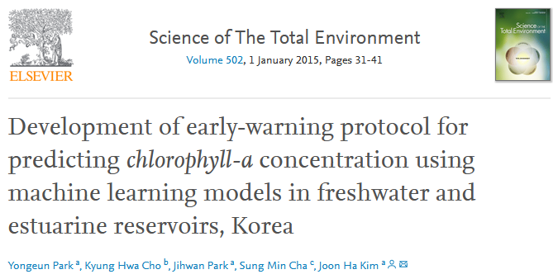

Slide 2
Models:
SVM and ANN
Target:
Chl-a Concentration in two reservoirs in Korea
Data:
Weekly data of 7 years
Water quality observations: chl-a, phosphate phosphorus, ammonium nitrogen,
nitrate nitrogen, water temperature
Meteriological data: solar radiation, wind speed
Notes:
Williams-Kloot test

Slide 3
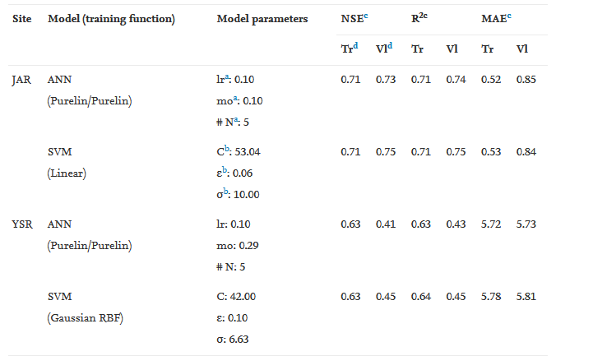
Matrices:
Major conclusions:
SVM better than ANN

